Slide 1
Version Control

Slide 2
Introduction
Motivation:
We need to manage documents (code, documentation, etc...) that are created by numerous people and change over time
We need to manage the documents for multiple products/projects and multiple variations of those products/projects
Other Names:
Revision Control
Source Control

Slide 3
Some Important Concepts
Repository:
The collection of documents/files
Can be centralized or distributed
Working Copy:
A copy (outside of the repository) of a document/file
Check-Out:
Making a working copy
Check-In/Commit:
Adding/returning a file to the repository

Slide 4
Approaches
Locking/Exclusivity/Single Check-Out:
Only one person can check a file out at a time
Other people can still view the file
Nobody else can check the file in (until the original person has done so)
Multiple Check-Outs:
Multiple people can check-out the same file
The first check-in always succeeds
Subsequent check-ins have to be merged (sometimes manually)

Slide 5
Architecture
Centralized/Client-Server:
A single, authoritative repository
Distributed/Peer-to-Peer:
Every peer has a repository
Repositories must be synchronized (by exchanging "change sets" or "patches")

Slide 6
Some Terminology
Branch/Fork:
The creation of multiple copies that will change in different ways in the future (e.g., products being developed for different platforms but have the same origins)
Change/Diff/Delta:
A particular modification
Change List/Update/Patch/Commit:
An atomic set of changes
Conflict:
Changes that can not be reconciled automatically (and, hence, must be resolved)
Head/Tip:
The most recent commit to either the trunk or a branch
Trunk:
The original code and revisions (i.e., before the first branch/fork)

Slide 7
Some Examples
The Early Systems:
Source Code Control System (SCCS) -- 1972, Marc Rochkind, Bell Labs
Revision Control System (RCS) -- 1982, Walter Tichy, Purdue
Concurrent Versioning System (CVS):
Released in 1986 (Dick Grune)
Centralized
Non-atomic (i.e., doesn't have "all or nothing" transactions)
Subversion:
Centralized
Released in 2001
Conceived as a replacement for CVS

Slide 8
Some Examples (cont.)
Git:
Distributed
Released in 2005
Based on experience with BitKeeper (which was used to develop the Linux kernel but stopped being free)
Initiated by Linus Torvalds
Mercurial:
Distributed
Released in 2005
Based on experience with BitKeeper (which was used to develop the Linux kernel but stopped being free)
Initiated by Matt Mackall

Slide 9
Git

Slide 10
Introduction
What is Git?
A version control system
Important Features:
Distributed
Built around commit objects that can be manipulated in a variety of ways

Slide 11
The Important Pieces
Repositories:
A repository is an archive
Working Trees:
A working tree is a directory/folder (on a filesystem) with an associated repository
Index:
An intermediate collection of changes (that need to be confirmed) before they can be moved from a working tree to a repository

Slide 12
Normal "Centralized" Work Cycle - Getting Started
Create the Central Repository:
Often handled by a third-party hosting services
Clone the Central Repository:
Each developer uses the git clone command

Slide 13
Normal "Centralized" Work Cycle - Day-to-Day
Using the Local Repository:
Use git checkout to checkout a working tree
Make changes to the documents in the working tree
Optionally add to the index using git add
Commit to the local repository from the index using git commit
Pushing New Commits to the Central Repository:
Attempt to update the central repository using the git push command
In the event of conflicts:
Use the git pull command to get the changes that others have made
Resolve the conflicts
Use git push to update the central repository

Slide 14
Toward a Revision History
A Commit:
A snapshot of a working tree at a particular point in time
A Branch:
A name of a commit
Created using git branch
Combined using git merge
The HEAD:
A reference to what is currently checked out (usually, though not always, a particular branch)

Slide 15
The Resulting Revision History
Getting Started:
The main development path is usually called "master"
It is nothing but a branch
Subsequently:
Each commit links back to one or more parents (forming a history)
Each commit contains a collection (specifically a tree) of blobs (Binary Large Object).

Slide 16
Other Work Cycles
Some Examples:
Feature Branching - all feature development takes place in a dedicated branch (not the master branch)
GitFlow - a strict branching model designed around project releases
External reference: link
Forking - Every developer has a server-side repository
Issues:
Longer-lived branches are riskier
One solution – using Feature Flags (reference)
The work cycle should allow for easy reversions (because things do go wrong)

Slide 17
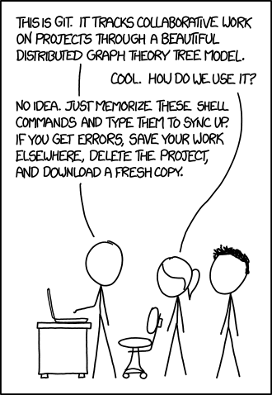
(Courtesy of xkcd)

